Slide 1

BATCH MEMBERS
JAYAPRIYA .K (511321104036) jayapriyakumaresan02@gmail.com
ANU.S (511321104005) s.anupriyanka1225@gmail.com
CHARISHMA.M (511321104014) charishmamasarapu@gmail.com
LAHARI.P (511321104045) laharipasala8@gmail.com

Slide 2
Project:
Applied Data Science
Future Sales Prediction

Slide 3
CONTENT:
OBJECTIVE
SALES FORECASTING
PROBLEM STATEMENT AND DESIGN THINKING
PRODUCT ANALYSIS
CUSTOMER ANALYSIS
CONCLUSION

Slide 4
OBJECTIVE
SALES FORECASTING IS TO PREDICT THE REVENUE OF THE COMPANY TO PREDICT IN FUTURE SALES.
SALES FORECASTING IS A LONG TIME GOAL THAT ACHIEVE IN SALES TEAM TO PUSH THE COMPANY FORWARD.
PREDICT THE QUALITATIVE ANALYSIS.
ACHIEVE A TIME SERIES.
ANALYSIS THE PROJECTION MODEL.
TO PREDICT THE CAUSAL MODEL FOR SALES ANALYSIS.

Slide 5

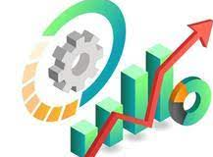
SALES FORECASTING:
Sales
forecasting
Process
Predicting future sales
Business or product
Helps
data
Planning
Budgeting
Historical
data
Decision
making
Market
research

Slide 6
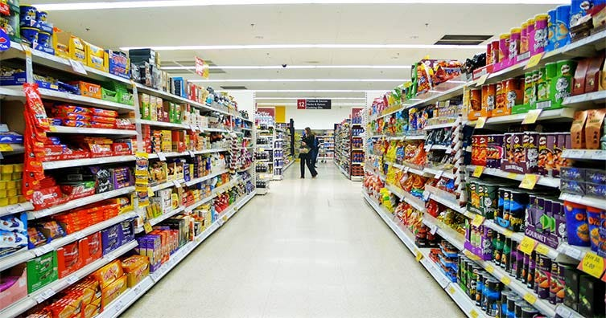
PROBLEM STATEMENT AND DESIGN THINKING
List out the goods and services.
Estimate how much product except to sell.
Define the price of good and services are sold.
Multiply the number sold by the price.
Determine the cost will produce and sell each goods and services.
Multiply the cost by estimated to sales volume.
Subtract the total cost from the total sales for sales prediction analysis.
→
GROCERY STORE

Slide 7
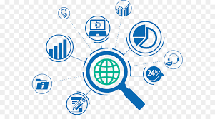
PRODUCT ANALYSIS
THE PROCESS OF ANALYZING HOW USERS ENGAGE WITH A PRODUCT OR SEVICES.
IT ENABLES TEAMS TO TRACK,VISUALIZE AND ANALYZE USER ENGAGEMENT AND BEHAVIOR DATA OR SERVICE.
TEAMS USE THIS DATA TO IMPROVE AND OPTIMIZE A PRODUCT OR SERVICE.
IT HELPS TO IDENTIFY WHAT THE DATA IS RELEVANT TO YOUR PRODUCT.
IT PERFORMS USER SESSIONS AND INTERACTIONS IN SOFTWARE APPLICATION.

Slide 8
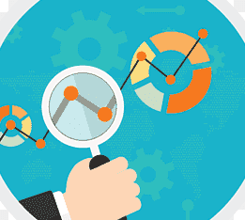
CUSTOMER ANALYSIS
CUSTOMER ANALYSIS IS THE SYSTEMATIC EXAMINATION OF A COMPANY’S CUSTOMER INFORMATION AND BEHAVIOUR TO IDENTIFY,ATTRACT AND RETAIN THE MOST PROFITABLE CUSTOMERS.
CUSTOMER LIFE TIME VALUE,ENGAGEMENT,SATISFACTION AND LOYALTY,CONVERSIOIN AND COMPLETION RATE.
IT INVOLVES IN GATHERING AND STUDYING DEMOGRAPHICS,BUYING PATTERNS,PRODUCT USAGE HISTORY,SPENDING HABITS,LOYALTY METRICS
IT MAKES AN ACCURATE DECISIONS FOR FUTURE DEVELOPMENT..

Slide 9
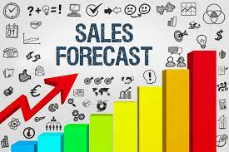
Benefits of sales prediction.
Makes strategic decisions
Set better goals
More accurate budgeting
Better prospecting
Better hiring
Resource planning
Smooth external operations
Determine your sales process

Slide 10
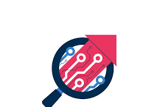
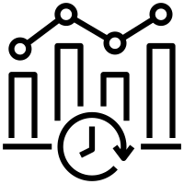
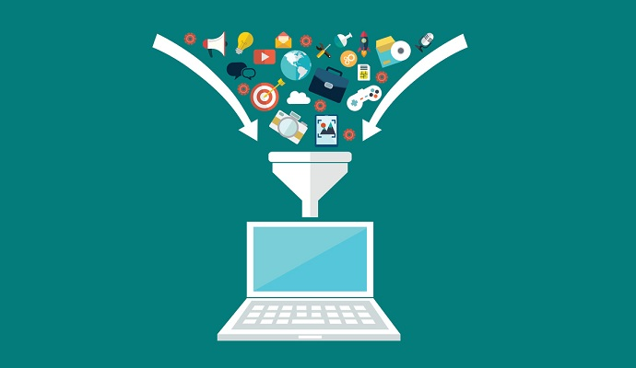
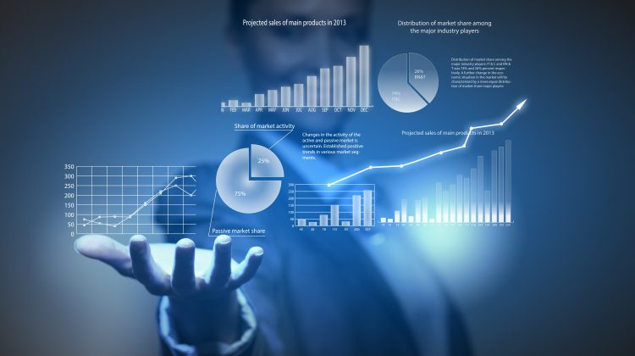
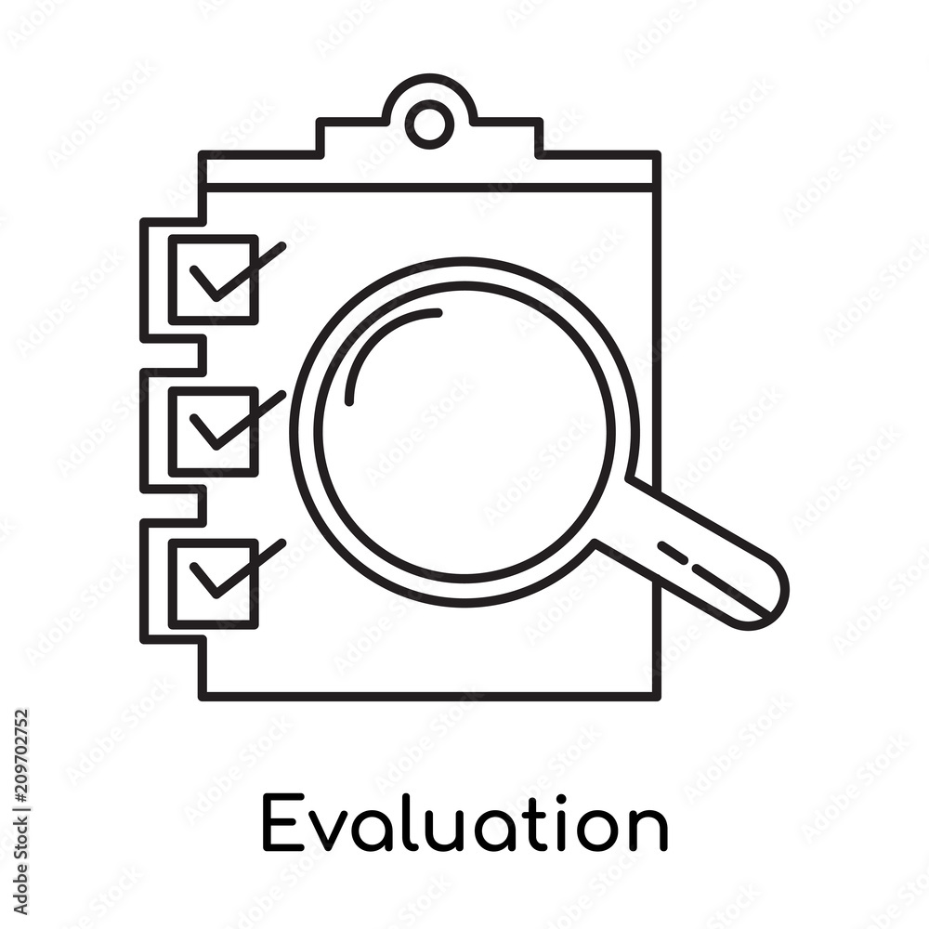
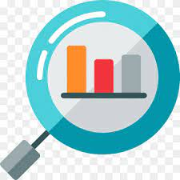

WORK FLOW
DATA
DATA PROCESSING
TIME SERIES
DATA ANALYSIS
EVALUATION
CUSTOMER ANALYSIS
PRODUCT ANALYSIS

Slide 11
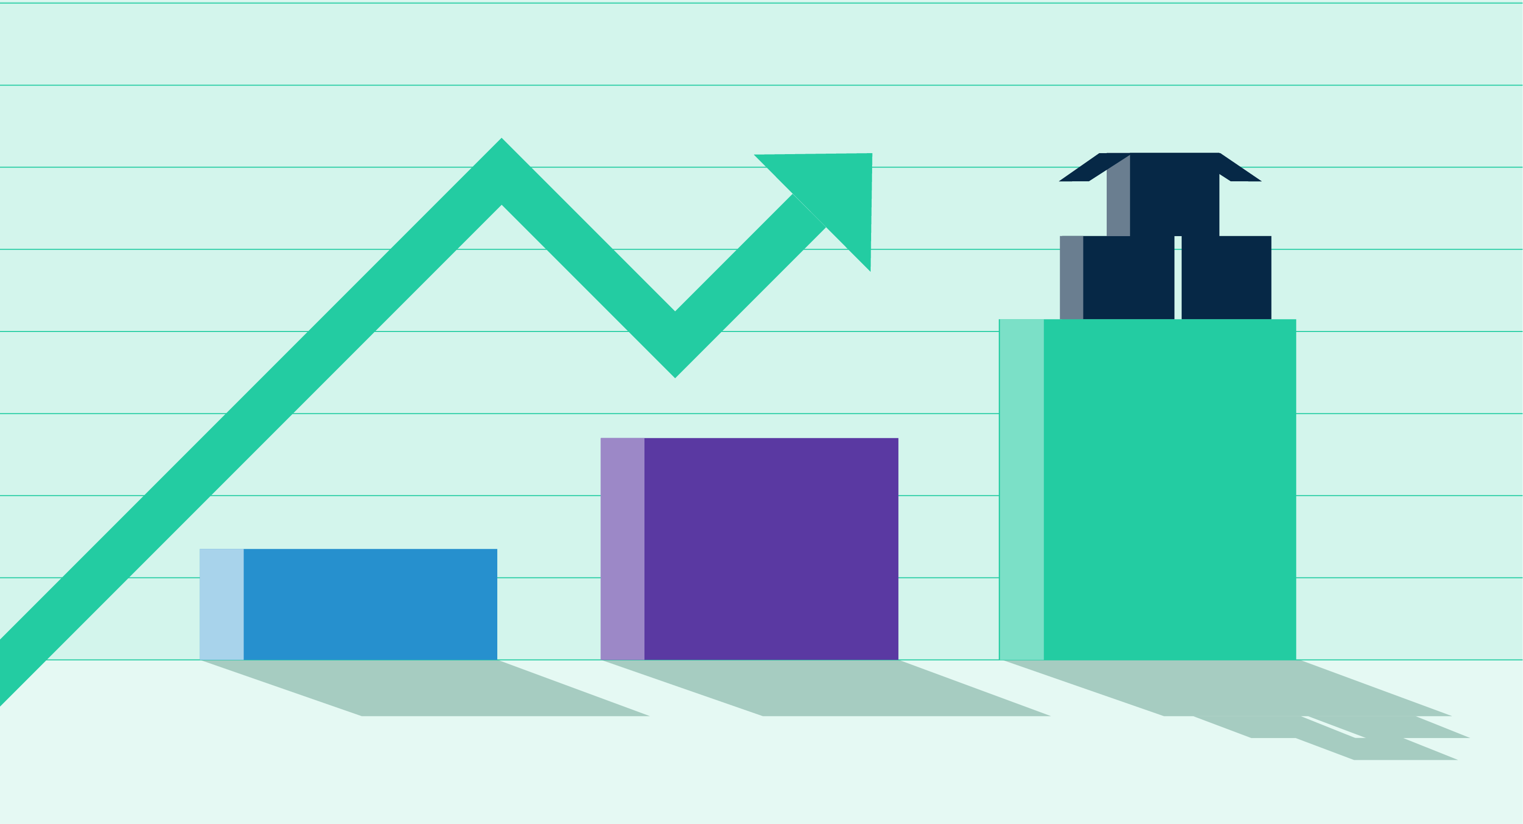
SALES PREDICTION
Predictive analytics uses historical data to predict future events
Data Science job opportunities in India are increasing as organizations seek to harness the power of data to drive decision-making.
The volume of data being generated continues to grow at an exponential rate, and being able to handle and analyze this data effectively is essential for making informed decisions and gaining valuable insights.

